Slide 1
Training regression network with weighted sampling of image windows
ref:
Berger et al., "An Adaptive Sampling Scheme to Efficiently Train Fully Convolutional Networks for Semantic Segmentation", https://arxiv.org/pdf/1709.02764.pdf
Please see the model zoo entry for instructions for downloading data and config file.
Training regression network with autocontext model
Please see the model zoo entry for instructions for downloading data and config file.
Parameters for config file in the regression section
Hybrid regression: autocontext + isample

Slide 2
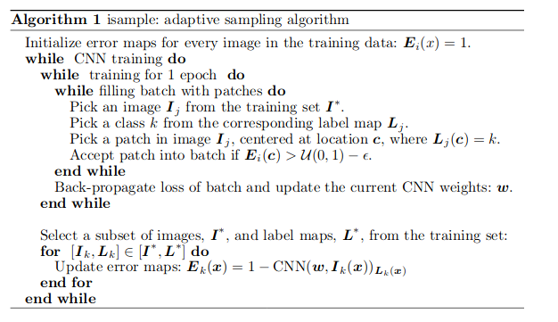

Slide 3
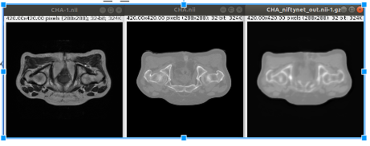
Autocontext after 500 iterations
tensorboard --logdir ~/niftynet/models/mr_ct_regression/logs

Slide 4
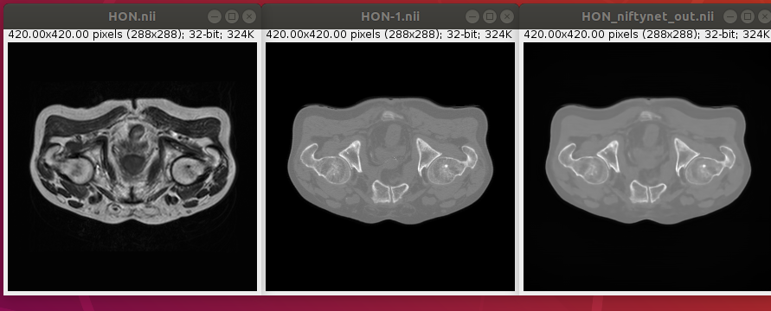
Hybrid: autocontext+isample after 10000 iterations

Slide 5
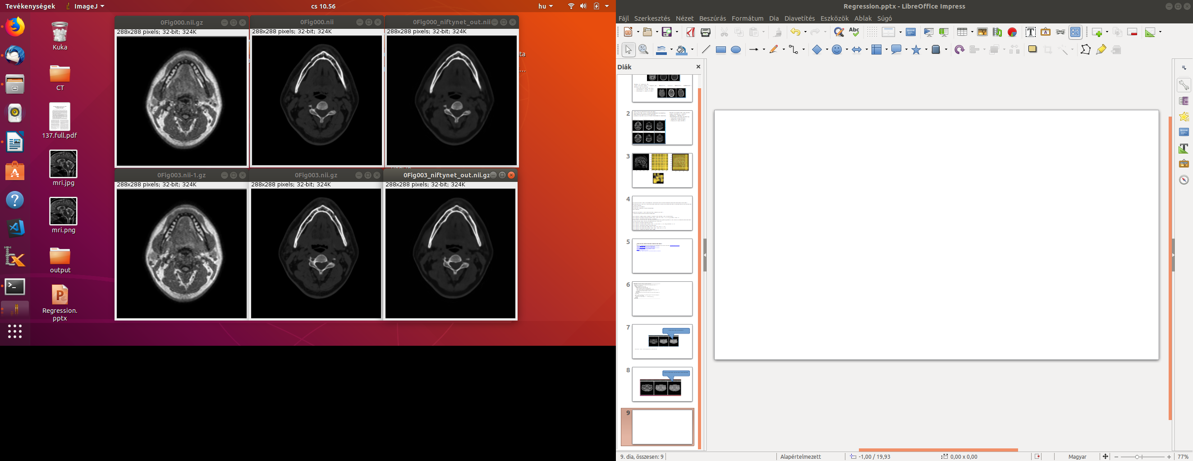
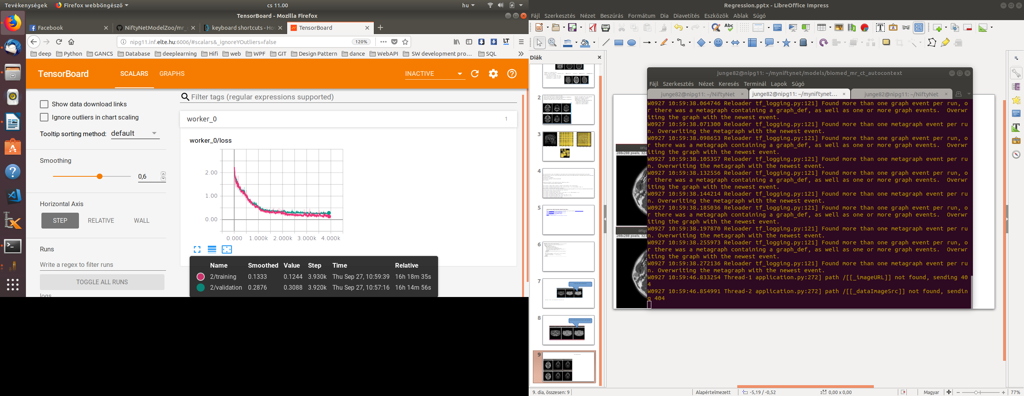
15 kép Model 3000-inference
1 patient 15 szelete egymásutániak

Slide 6
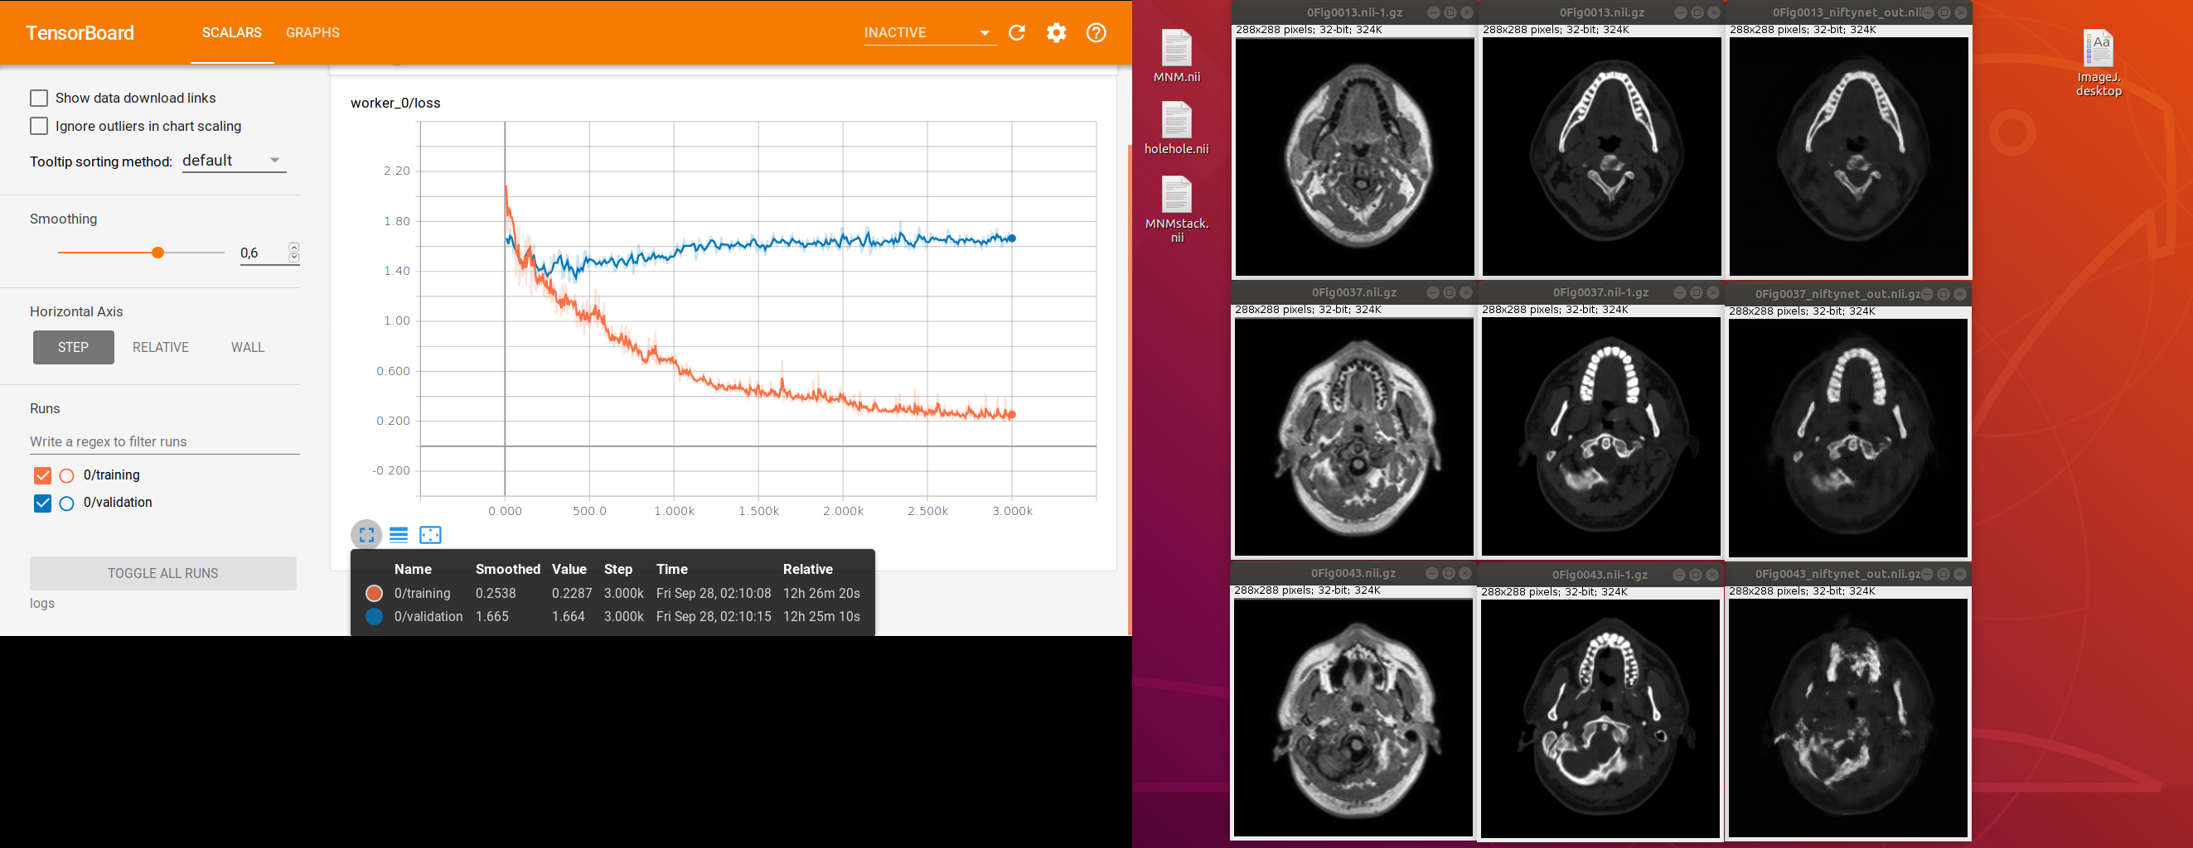
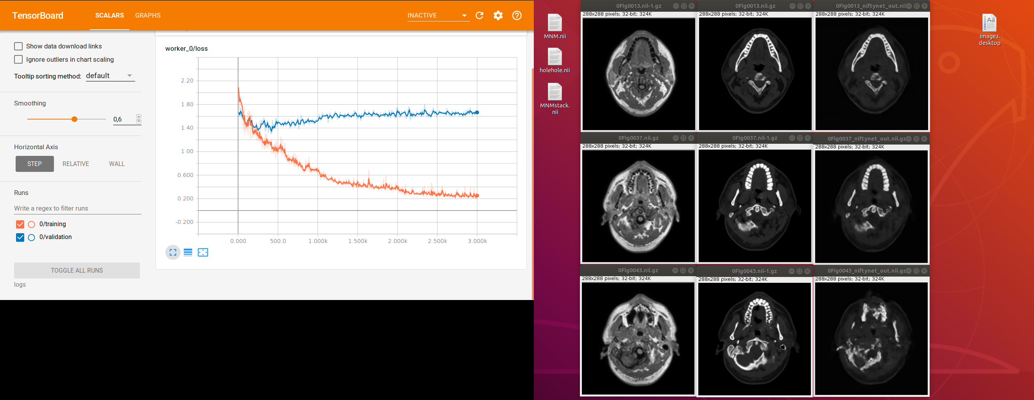
1 patient minden harmadik szelete összesen 15 db

Slide 7
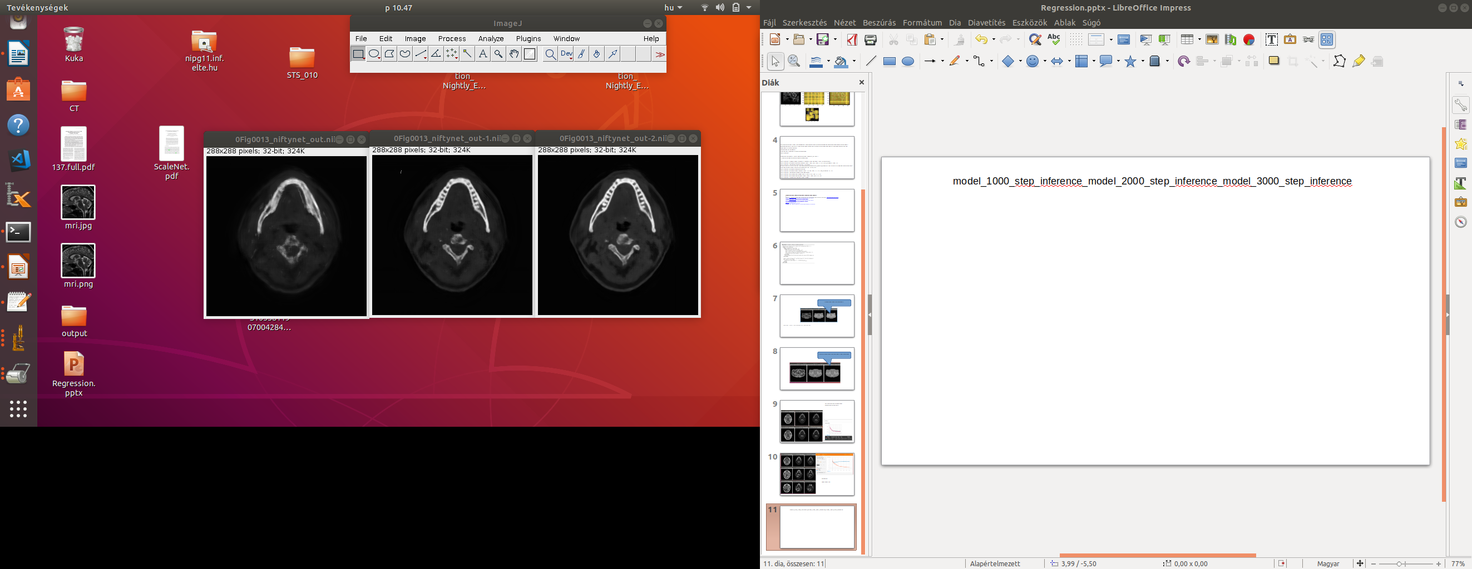
model_1000_step_inference_model_2000_step_inference_model_3000_step_inference
Anna ellenére,hogy a validaciós görbe stagnál, a kép élesedik a model_inference lépések ismétlődésének köszönhetően

Slide 8
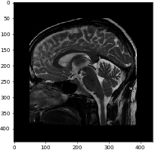
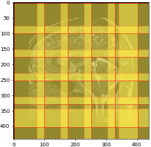
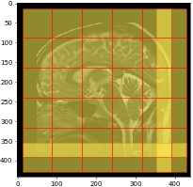
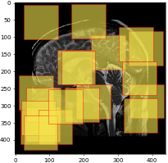
Példa ablakolásra-mintevételezésre-paddingre-borderingre

Slide 9

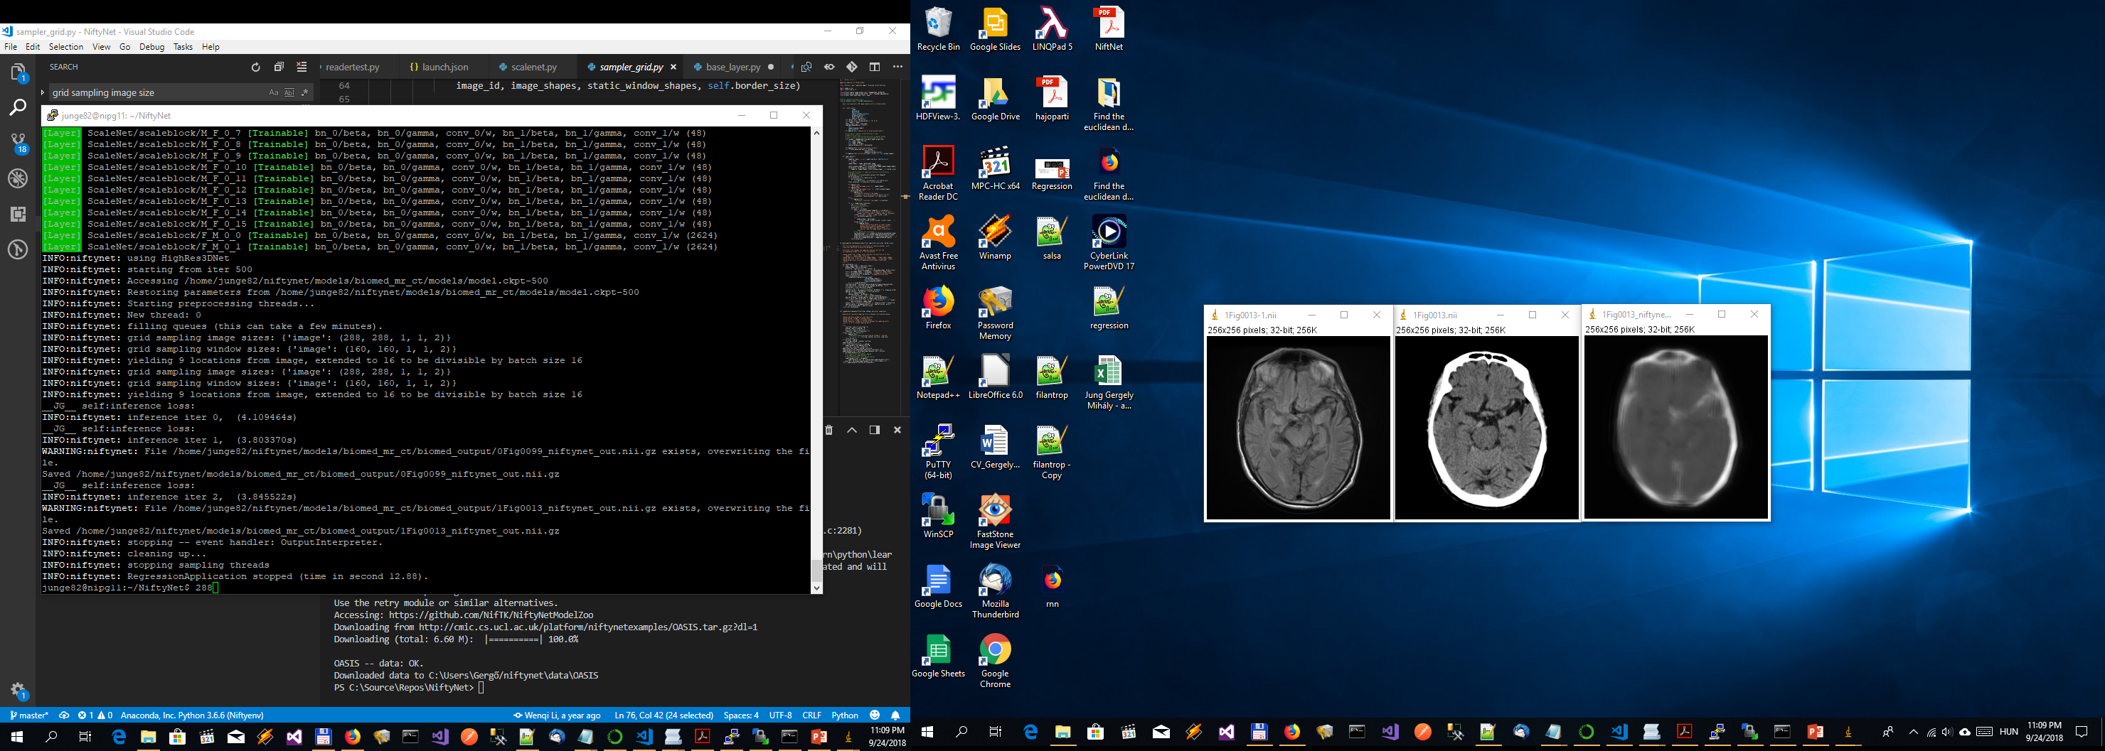
Ilyen volt
Number of subjects 39,
input section names: ['subject_id', 'MODALITY1', 'context', 'MODALITY2', 'SAMPWEIGHT’]
Dataset partitioning:
-- training 35 cases (89.74%),
-- validation 2 cases (5.13%),
-- inference 2 cases (5.13%).

Slide 10
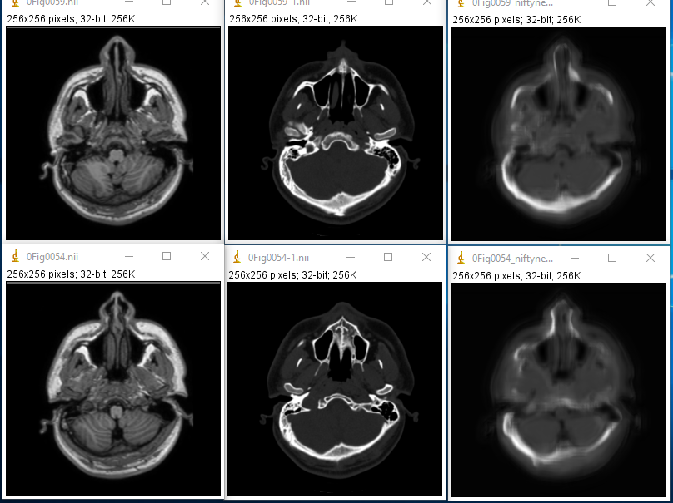
INFO:niftynet:2018-09-25 00:13:47,804:
training iter 400, loss=1.0765233039855957 (8.042679s)
INFO:niftynet:2018-09-25 00:13:50,358:
validation iter 400, loss=1.211607575416565 (2.554214s)
Number of subjects 29, input section names: ['subject_id', 'context', 'MODALITY1', 'MODALITY2', 'SAMPWEIGHT']Dataset partitioning:
-- training 25 cases (86.21%),
-- validation 2 cases (6.90%),
-- inference 2 cases (6.90%).
Ilyen volt

Slide 12
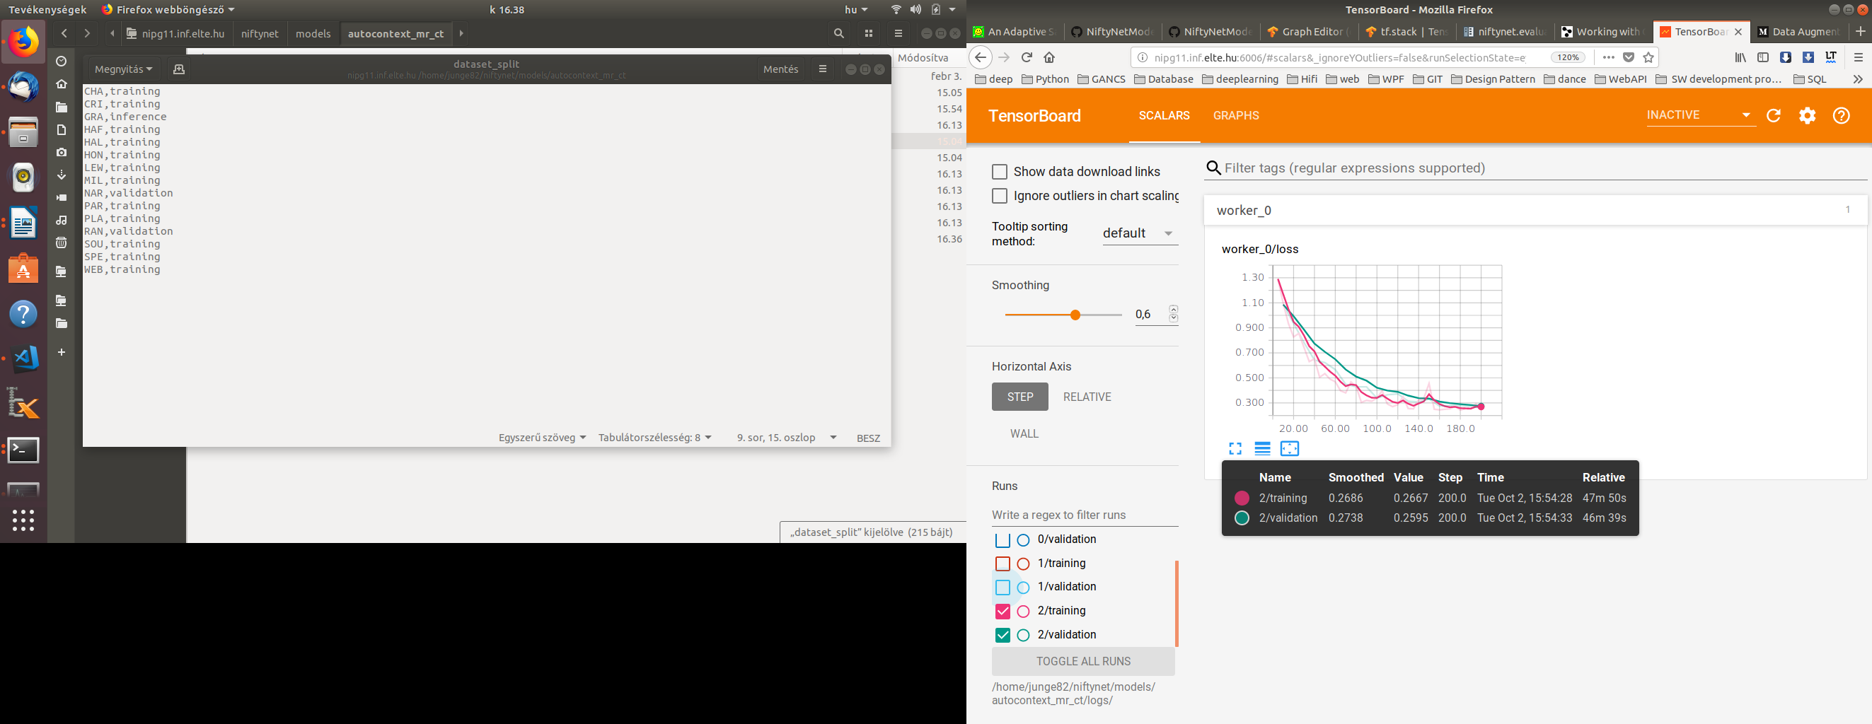
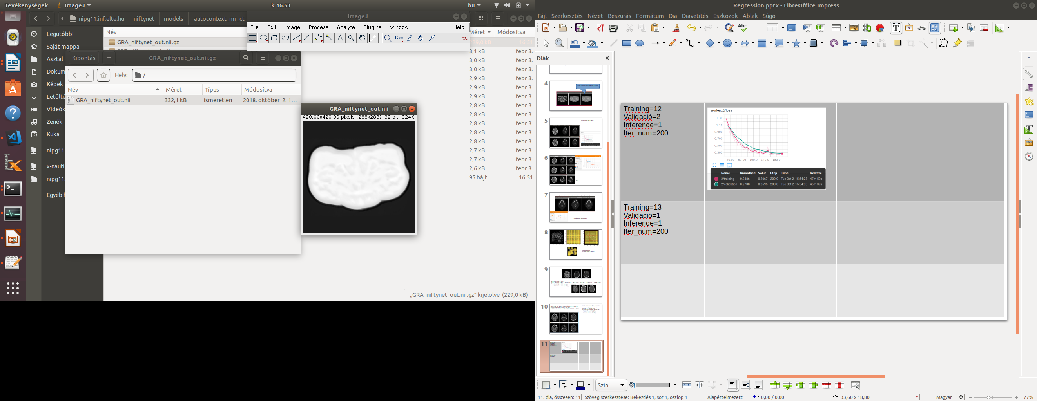
Training=12 CHA..WEB Validació=2 NAR,RAN Inference=1 GRA Iter_num=200 0.26,0.27

Slide 13
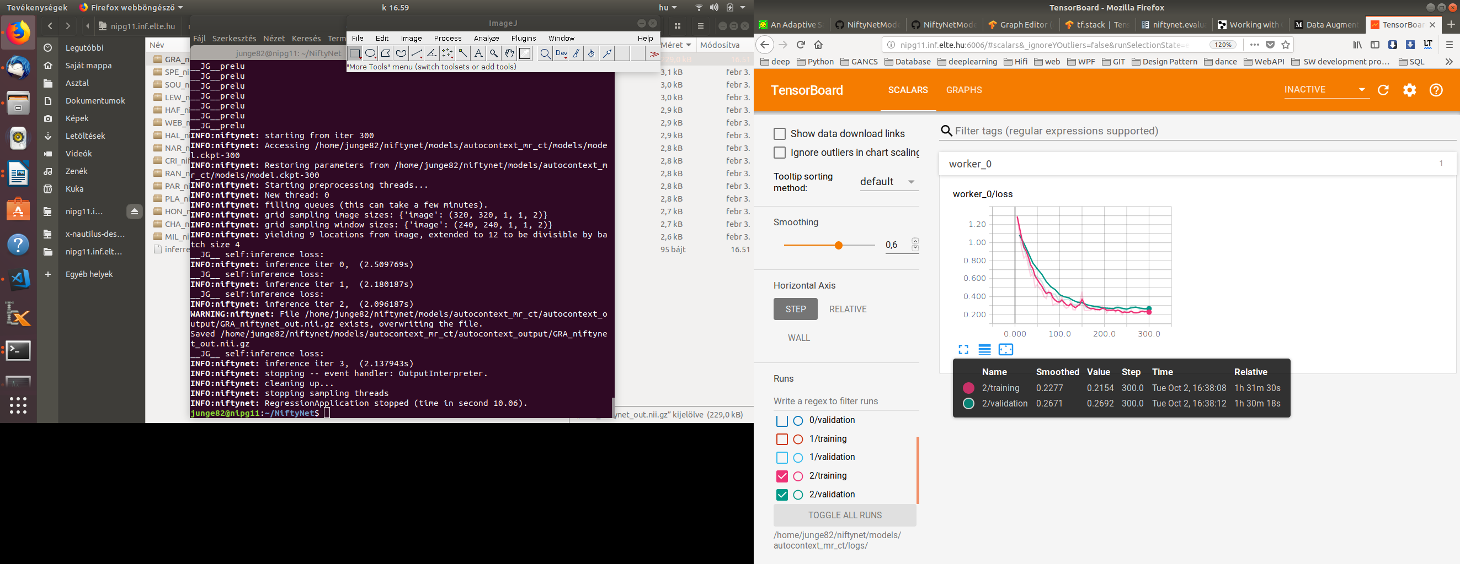
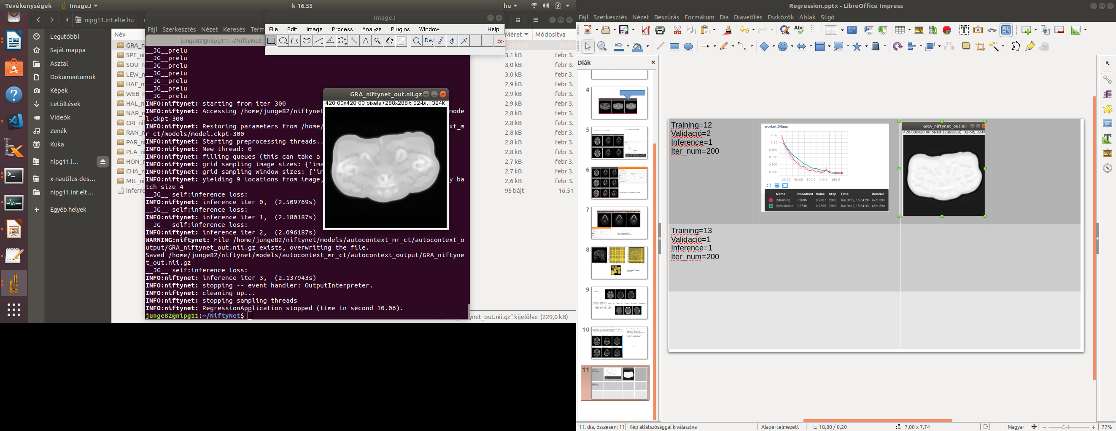
Inference GRA Iter_num=300 0.21,0.26 Inference GRA

Slide 14
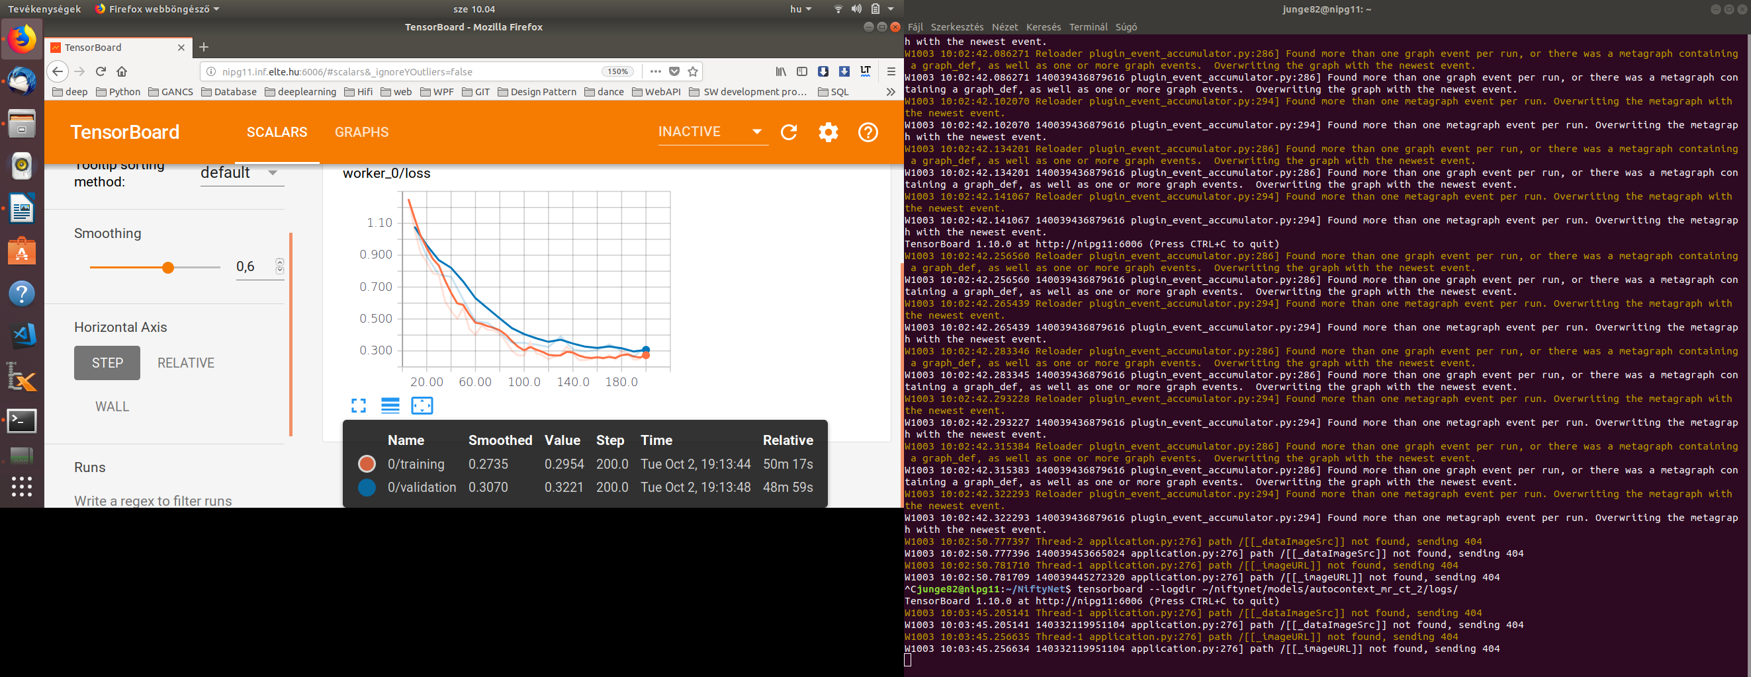
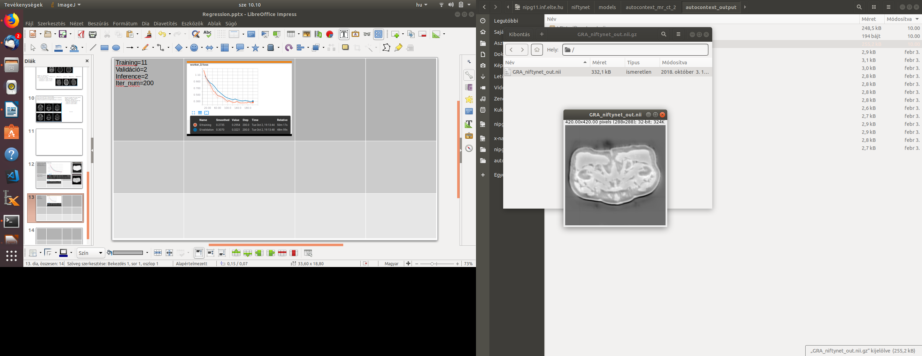
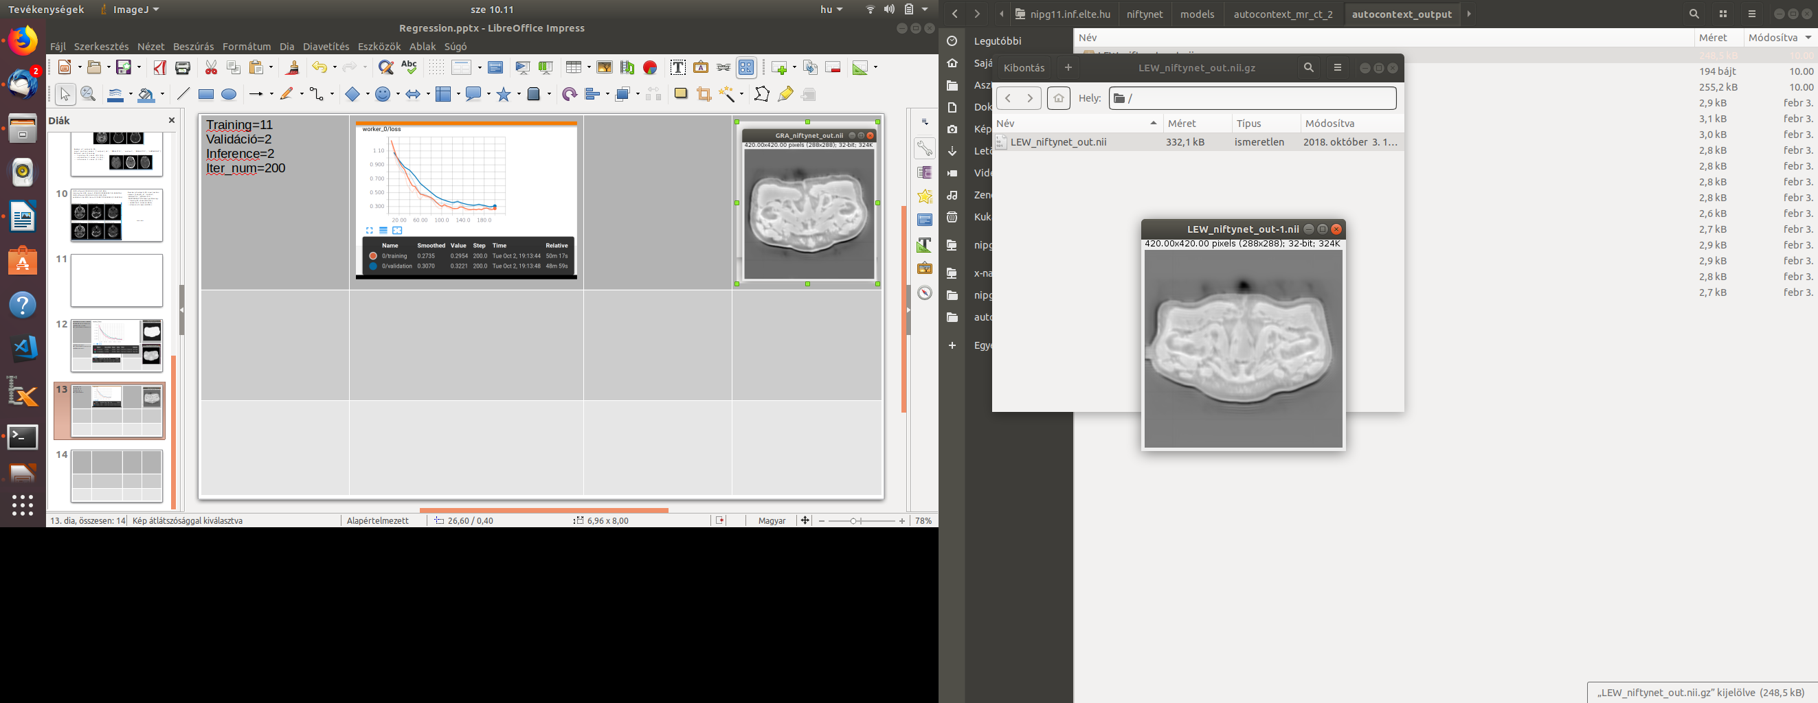
Training=11 Validáció=2 Inference=2 Iter_num=200

